Slide 1
Discover Access for SharePoint Making SharePoint Accessible and Usable
David Best – Accessibility IT Specialist, BEST Consulting
William F. Nagle – VP of Product Management, Discover Technologies

Slide 2
BEST Consulting and Discover Technologies
Discover Technologies
Provides services and information management solutions
Expertise in ECM, BDM and search
Creators of the Discover Access suite
BEST Consulting
David Best, Accessibility IT Specialist
Business and Educational Services in Technology (BEST)
Helping organizations to increase productivity and market growth through innovation and collaboration

Slide 3
Accessibility with Usability
The Discover Access solution drastically improves SharePoint usability for visually impaired users. Because of Discover Access, a visually impaired individual can accomplish tasks with much greater efficiency than if they were using the out of the box interface.
- AFB Consulting, February 2016

Slide 4
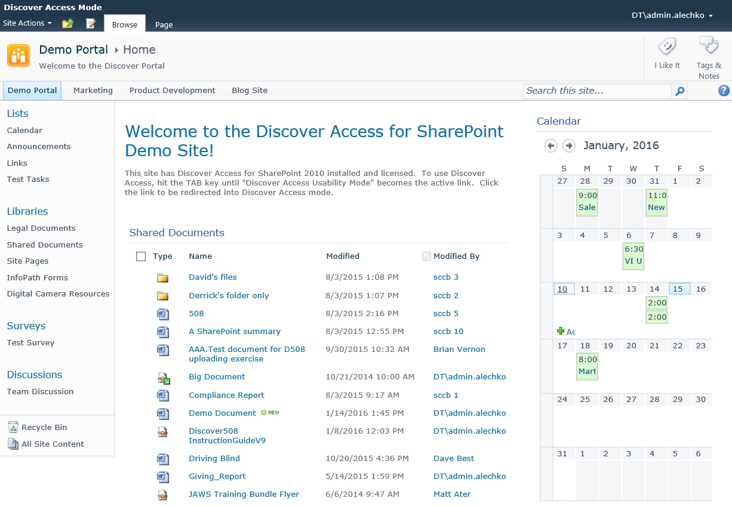
Native SharePoint 2010 Team Site
Notes:
How Discover Access for SharePoint works:
Discover Access for SharePoint enables a new mode for SharePoint that allows you to toggle between the default view to…

Slide 5
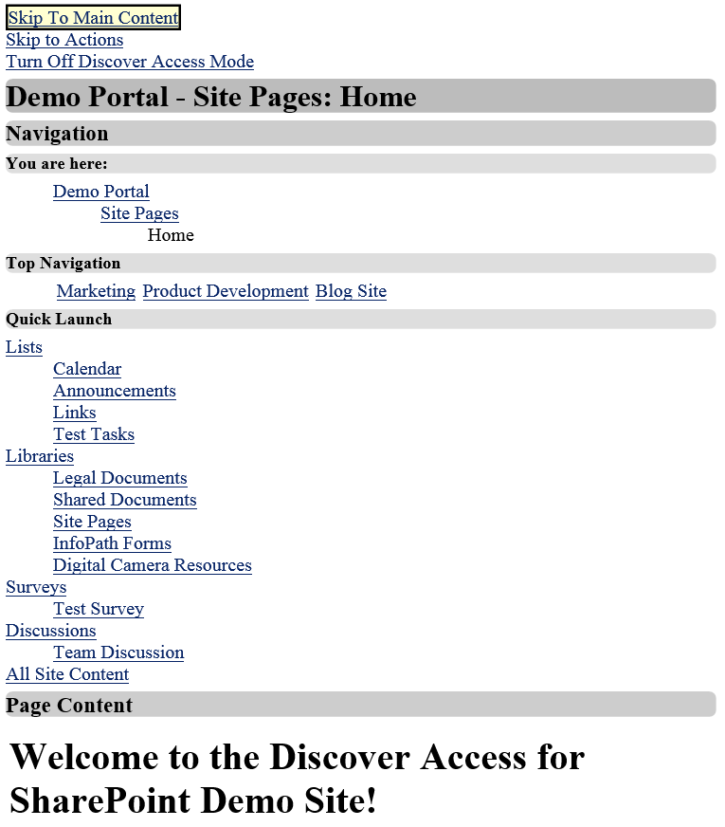
Discover Access for SharePoint 2010 Team Site
Discover Access for SharePoint “Usability Mode”
Notes:
How Discover Access for SharePoint works:
… “Usability Mode.”
This mode is provided for the entire SharePoint site thru a server side install. No coding is required.
Running in this usability mode, the blind and visually impaired user will experience drastically enhanced accessibility thru improved navigation, 100% keyboard access and overall enhanced usability.
Additionally, benefits of this technology extended to the sighted user in the following ways:
Many sighted users prefer the consistent, plain interface for clear and concise navigation,
Mobile users of SharePoint will benefit from this same consistent interface from devices like a ruggedized laptop to a smart phone, and
Field user with bandwidth limitations will experience improved response times, up to 80% quicker when using a satellite phone for internet access

Slide 6
Discover Access Field Usability
Discover Access for SharePoint improves field usability by:
Providing streamlined interface & left justification
Eliminating pop-ups
Eliminating Silverlight
Only presents necessary content
Reduces actions required to view/edit
Notes:
Eliminating pop-ups
Eliminating Silverlight
Only presents content related to completing task - Example: On a form screen we only show the form itself, not the background contents, navigation, master page, ribbon, etc.
Reduces actions required to view/edit - Example: Show all metadata and actions for a document on the document details page (no need to click menus, ribbons, etc.)

Slide 7
Quantifiable Accessibility Improvements
Notes:
With Discover Access for SharePoint activated, WCAG 2.0AA error are warning are practically eliminated.
Chart shows error and warning count in excess of 15 and 50 respectively for standard SharePoint home page, calendar view, document library and site permission pages. With Discover Access, these errors and warning are virtually eliminated – error count ranges from 0 to 2, and warning count ranges from 1 to 12.

Slide 8
Low Bandwidth Time Savings
Over an 80% improvement
Notes:
Here’s an example on the time saving experienced when bandwidth is restricted to that of a satellite phone.
Response time of home page, calendar and documents show 80% improvement in response time when bandwidth is restricted to 750 Kbps.

Slide 9
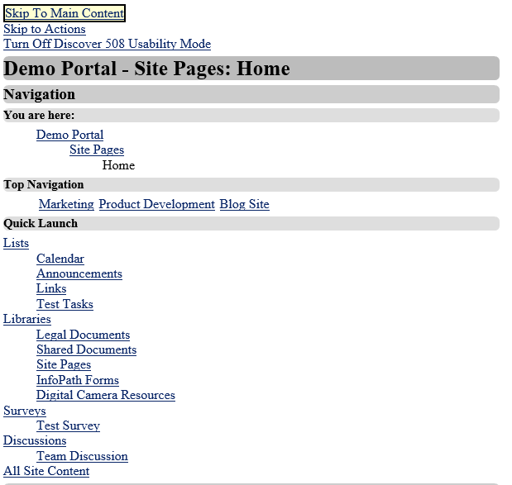
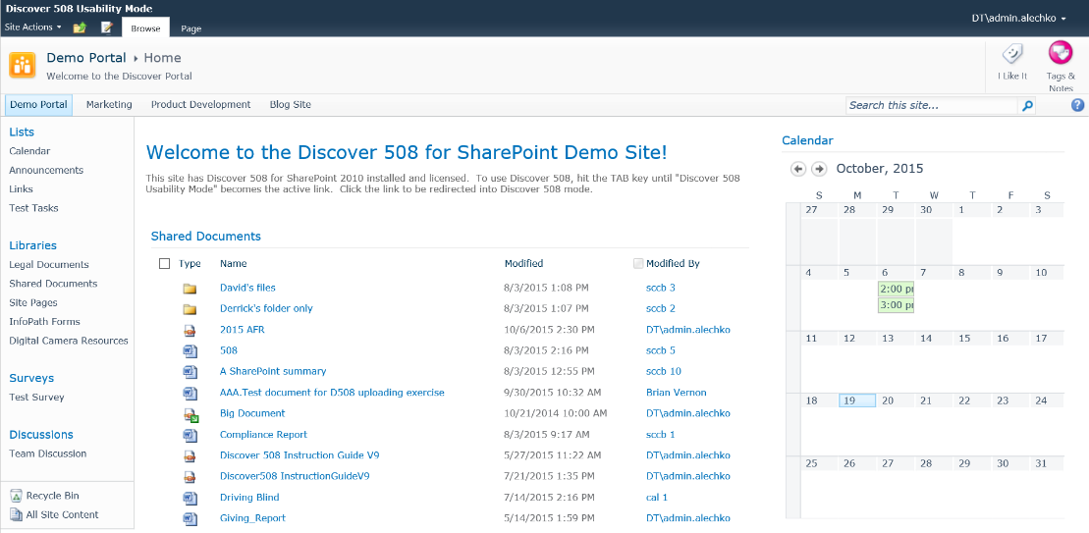
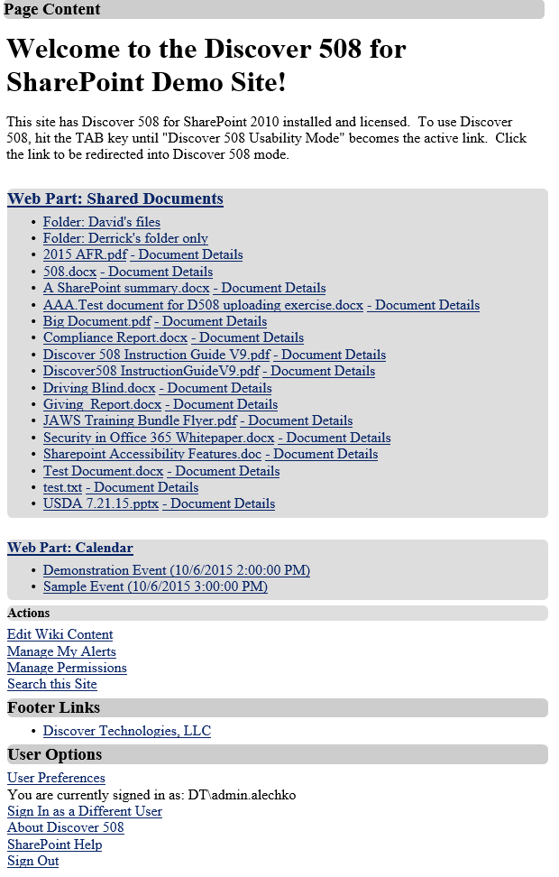
Accessible and Usable Demonstration
SharePoint
Discover Access for SharePoint

Slide 10
How to Learn More
Visit www.davidbest.ca
Stop by booth #
Visit DiscoverTechnologies.com
Read the AFB report on Discover Access for SharePoint

Slide 11
Working with Key Organizations
Notes:
We are working with key Organizations/Partners in the Accessibility/Assistive Technology space.
Discover Technologies is working closely with leading companies such as Freedom Scientific, the manufacturer of JAWS, to deliver a training program for Discover 508. Also, the AFB has produced a compelling report that compares out of the box SharePoint vs. Discover 508, for usability. The report is 7 pages and gives an overview of why AFB chose Discover 508 to be a more usable solution compared to SP OOTB.
Columbia Lighthouse for the Blind, another Partner created a 2 day class for blind and low vision users to teach them how to use SharePoint using our Discover 508 solution.
On the customer front, we recently helped the National Federation of the Blind (NFB) rollout SharePoint O365, our cloud option for the solution, and they will be using the Discover 508 product as their interface to perform collaborative tasks. Interestingly, 70% of the workforce at NFB is sighted, but all of their executive management team is blind.
Other enterprise customers include Health Resources Services Administration (HRSA) and Centers for Medicare & Medicaid Services (CMS), both part of Health and Human Services (HHS), as well as the South Carolina Commission for the Blind.
CMS deployed Discover 508 across their entire enterprise because they recognized the value of offering the solution to their blind and sighted users. In fact, many of our customers are sighted users and they prefer our version of SP using Discover’s Usability Mode to SP OOTB because it is easier and provides them more efficiency so that they can better perform their jobs.
Some of our newest customers are Securities and Exchange Commission, Environmental Protection Agency, and State of Minnesota.

Slide 12
Discover Access: Extending SharePoint’s More Accessible Mode
Feature | SharePoint “More Accessible Mode” | Discover Access Usability Mode
Accessible Breadcrumb Trail | ✗ | ✓
Skip to Main Content | ✓ | ✓
Skip to Actions | ✗ | ✓
Eliminate Pop-Ups and Silverlight | ✗ | ✓
100% Accessible by Keyboard | ✗ | ✓
Compatible with Zooming Tools | ✗ | ✓
Compatible with Speech-to-text Tools | ✗ | ✓
Stores Usability Preferences in User Profile | ✗ | ✓
Provides Customizable Interface for Colors and Font sizes | ✗ | ✓
508 Compliant Mobile View | ✗ | ✓
Replaces HTML Tables and Calendars with lists of links | ✗ | ✓
Replaces Menus with Lists of Links | ✓ | ✓
Updates Heading Structure for Section 508 and WCAG 2.0 Compliance | ✗ | ✓

