Slide 1
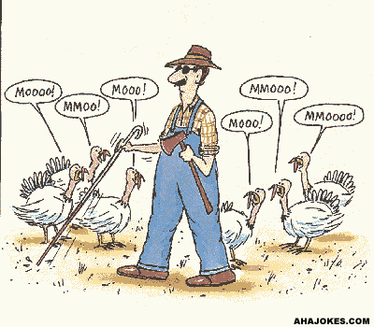

Ontario Digital Summit
      BEST Consulting
Information that cannot be translated into knowledge is just noise.
Learn more about the digital divide gap

